Slide 1

AN ASSEMBLY FOR OUR SCHOOL
The Pope Comes
to the Hills
Pope Leo XIV visits Bamenda, Cameroon
16 APRIL 2026

Slide 2
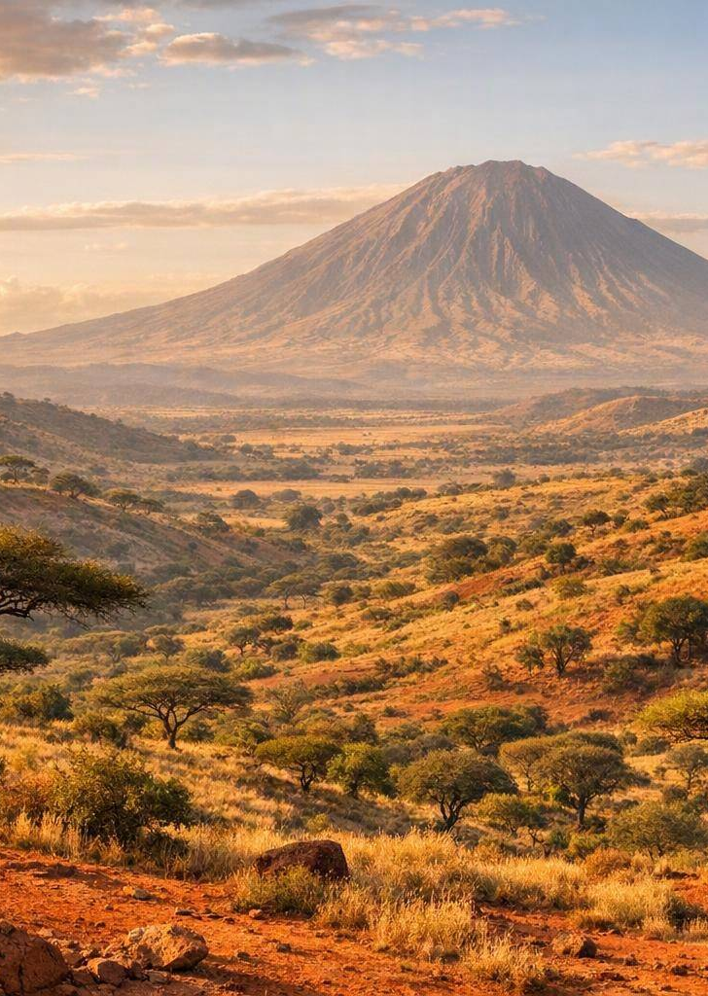
WHERE IN THE WORLD?
Meet Cameroon
Often called “Africa in miniature” — rainforests, mountains, savanna and coast in one country.
Central Africa A large country on the west coast, bigger than the UK.
~31 million people Over 250 ethnic groups and languages live side by side.
Two official languages English and French — a legacy of colonial history.
A Catholic heartland Roughly 1 in 3 Cameroonians is Catholic.
Pope Leo XIV in Bamenda • Assembly Resource • 2 / 10

Slide 3
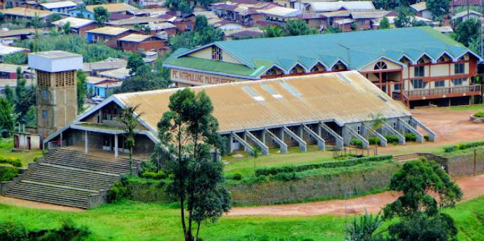
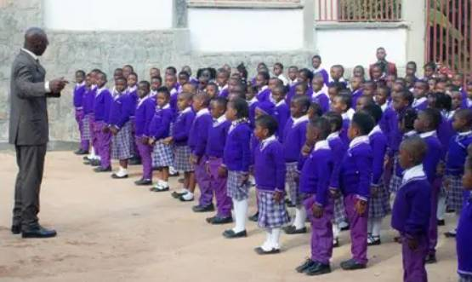
THE CITY ON THE HILLS
Bamenda — “Abakwa”
Up in the hills About 1,600 m high — cool, green and famously scenic.
Home to ~600,000 One of Cameroon’s biggest and busiest cities.
Pidgin English Heard in shops and on the streets every day.
A lively highland city and capital of Cameroon’s English-speaking North-West Region.
Pope Leo XIV in Bamenda • Assembly Resource • 3 / 10

Slide 4
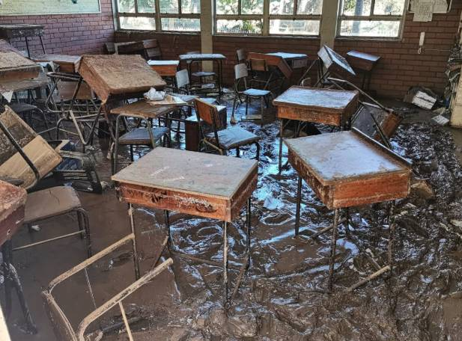
WHY PEACE IS NEEDED
A City That Has Known Hardship
Since 2016, Cameroon’s English-speaking North-West and South-West have been caught in a conflict often called the “Anglophone Crisis” — a struggle between the English-speaking minority and the government.
10 yrs
500,000+
Schools
of conflict
displaced
closed
A sign of hope: Christian and Muslim leaders have come together to form a Movement for Peace.
Schools have been forced to close.
Pope Leo XIV in Bamenda • Assembly Resource • 4 / 10

Slide 5
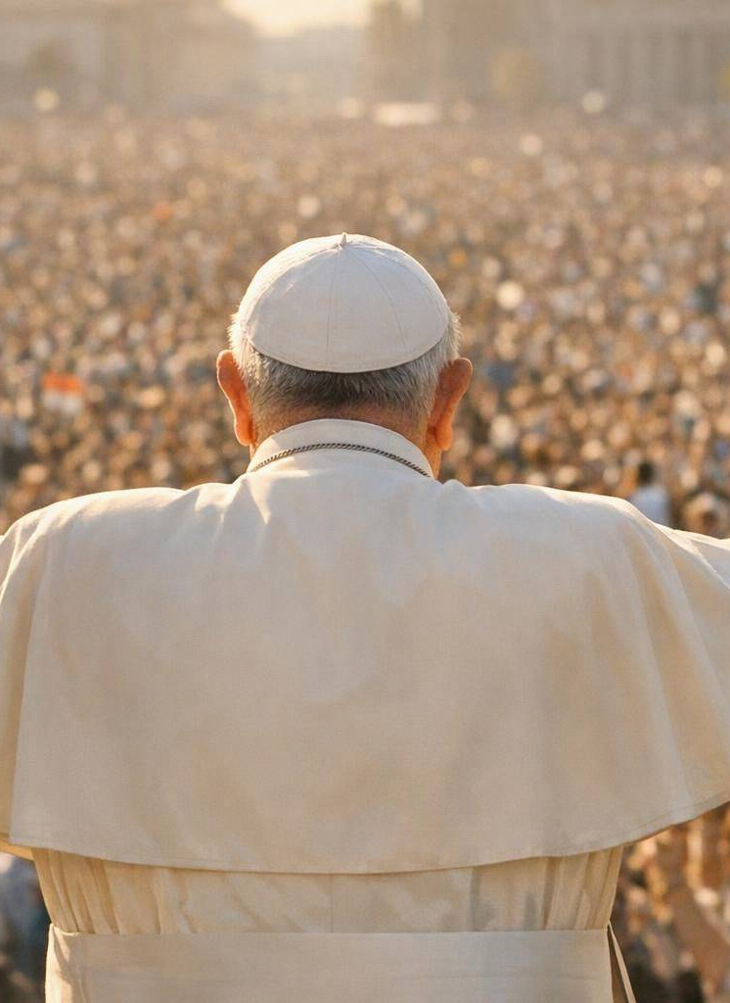
MEET THE MESSENGER
Pope Leo XIV
The first American pope Born Robert Prevost in Chicago in 1955.
A missionary at heart Served for years in Peru as an Augustinian friar.
Elected in 2025 Became leader of the Catholic Church on 8 May 2025.
A peacemaker His motto: “In the One, we are one.”
Africa 2026: an 11-day journey across 4 countries — Bamenda was its heart.
Pope Leo XIV in Bamenda • Assembly Resource • 5 / 10

Slide 6
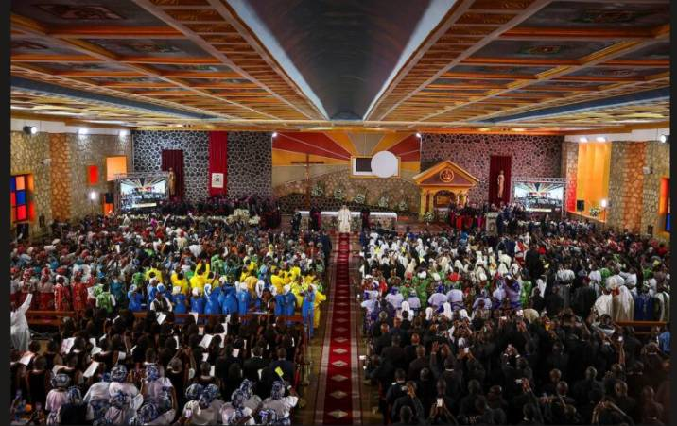
THURSDAY 16 APRIL 2026
The Big Day in Bamenda
Touchdown 11:00
The Pope lands at Bamenda Airport to huge, cheering crowds.
11:0
Meeting for Peace 11:30
He gathers with community and faith leaders at the Cathedral.
Open-air Mass 15:30
Thousands of the faithful celebrate Mass at the airport.
Saint Joseph’s Cathedral, Bamenda
Pope Leo XIV in Bamenda • Assembly Resource • 6 / 10

Slide 7
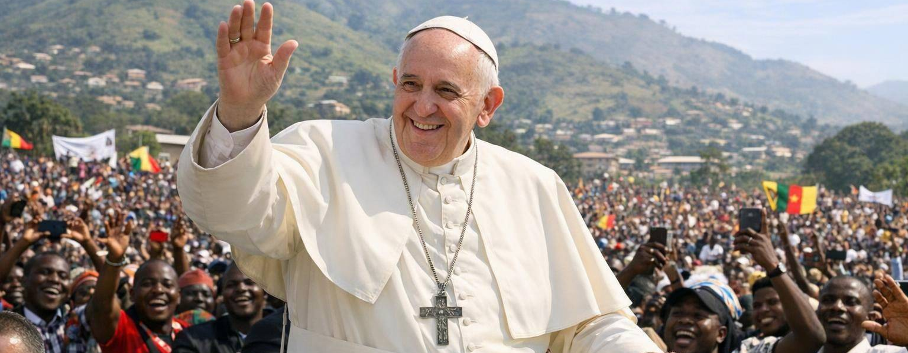
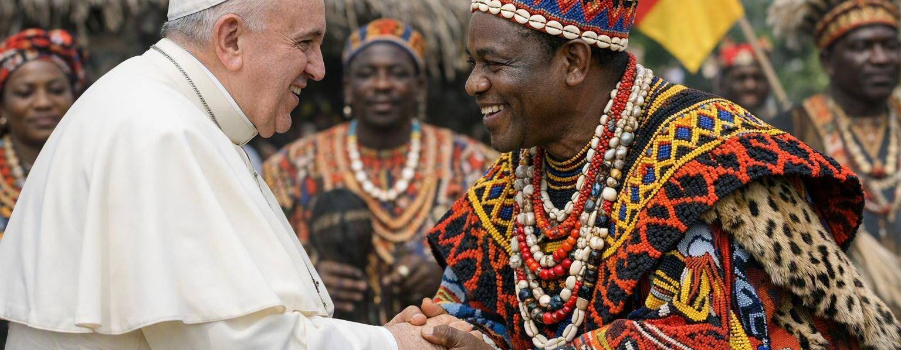
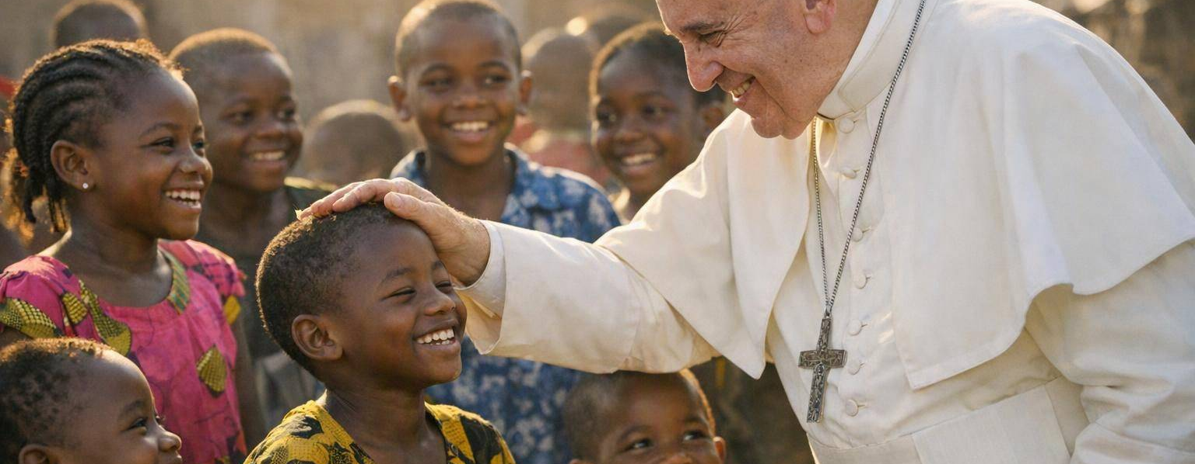
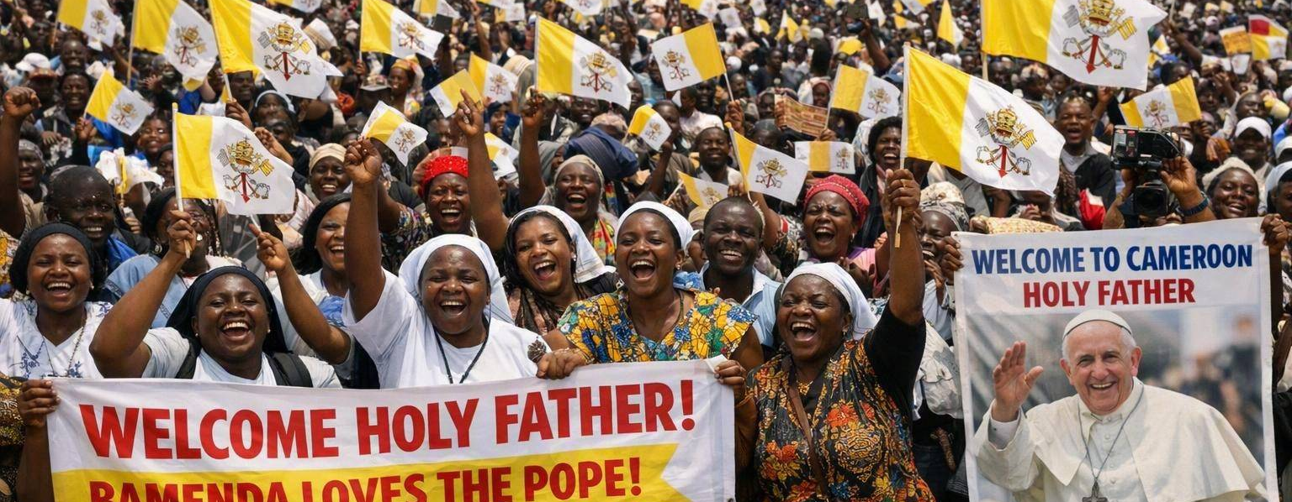
IN PICTURES
Pope Leo XIV in Bamenda
Greeting the cheering crowds
Honouring a Grassfields Fon
A blessing for the children
A sea of welcome flags
Pope Leo XIV in Bamenda • Assembly Resource • 7 / 10

Slide 8
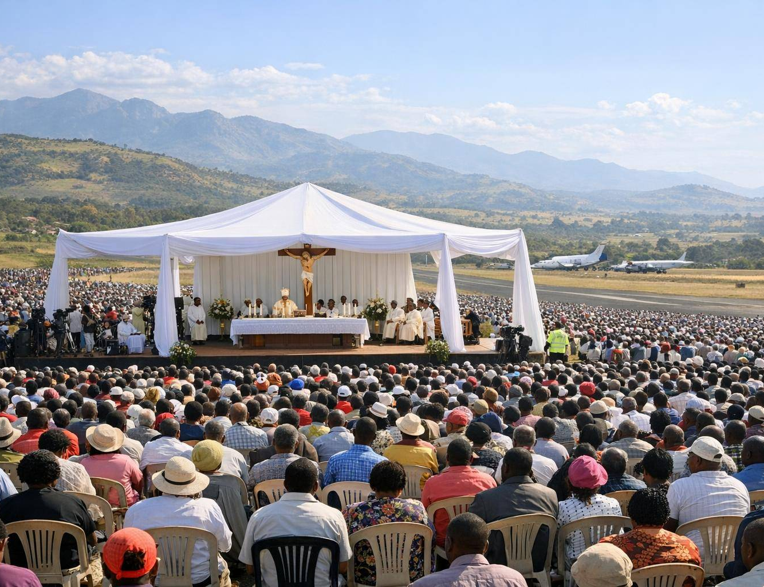
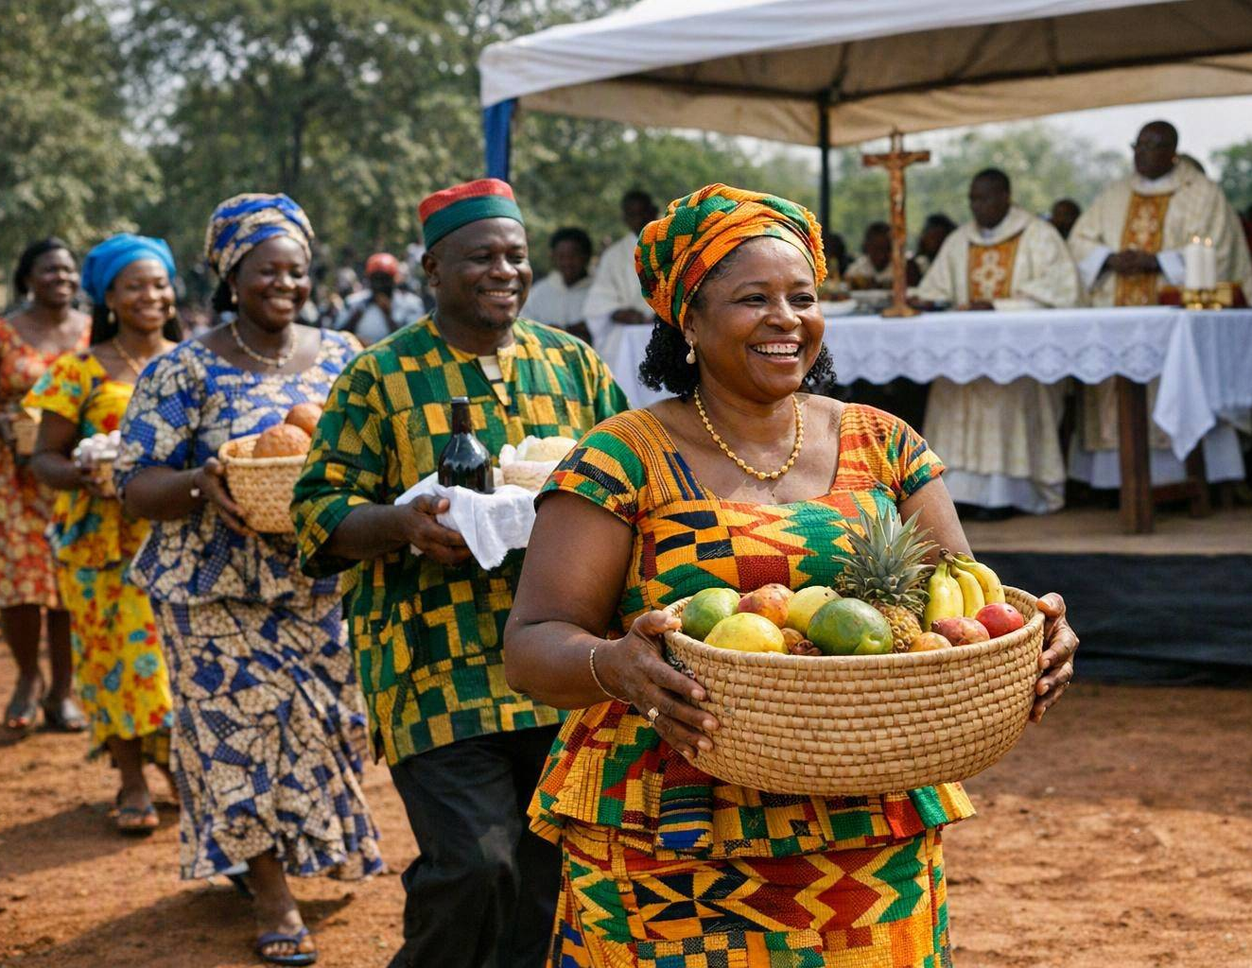
AT THE OPEN-AIR MASS
Highlights from the Mass
Thousands gathered
The faithful filled the airfield for an open-air Mass under the highland sun.
A festival of colour
Choirs, drums and dancing wove Grassfields culture into the celebration.
Gifts of the people
An Offertory procession carried woven baskets and local gifts to the altar.
“The word of the Lord opens up new possibilities — today and not tomorrow, now and not in the future.”
— Pope Leo XIV
Pope Leo XIV in Bamenda • Assembly Resource • 8 / 10

Slide 9

THE MESSAGE
“I am here to
proclaim peace.”
— Pope Leo XIV, in Bamenda
“Bamenda, today you are the city on the hill, resplendent in the eyes of all.”
Archbishop Nkea welcomed him as “a messenger of peace, an ambassador of reconciliation.”

Slide 10
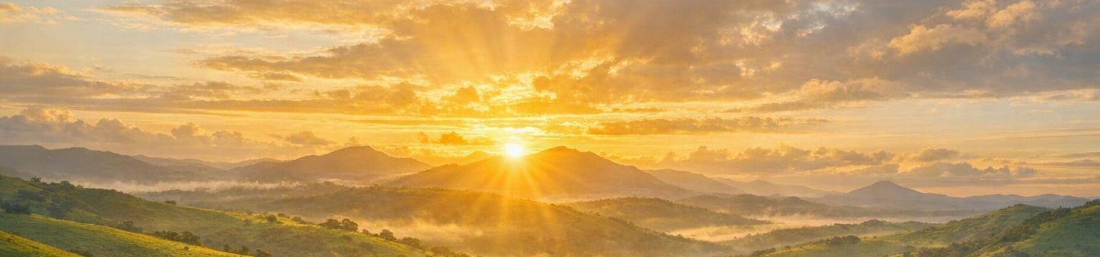
WHAT CAN WE TAKE AWAY?
Why It Matters to Us
One visit. A message of hope that travels far beyond the hills of Bamenda.
Peace is everyone’s work
People of different faiths can choose to build peace together.
Think & Talk
Who are the peacemakers in your own life?
Where could you “show up” for someone who feels forgotten?
What is one act of peace you could choose today?
Presence matters
Standing with people who suffer brings real hope.
Hope over despair
“Today and not tomorrow, now and not in the future.”
Pope Leo XIV in Bamenda • Assembly Resource • 10 / 10

