Slide 1
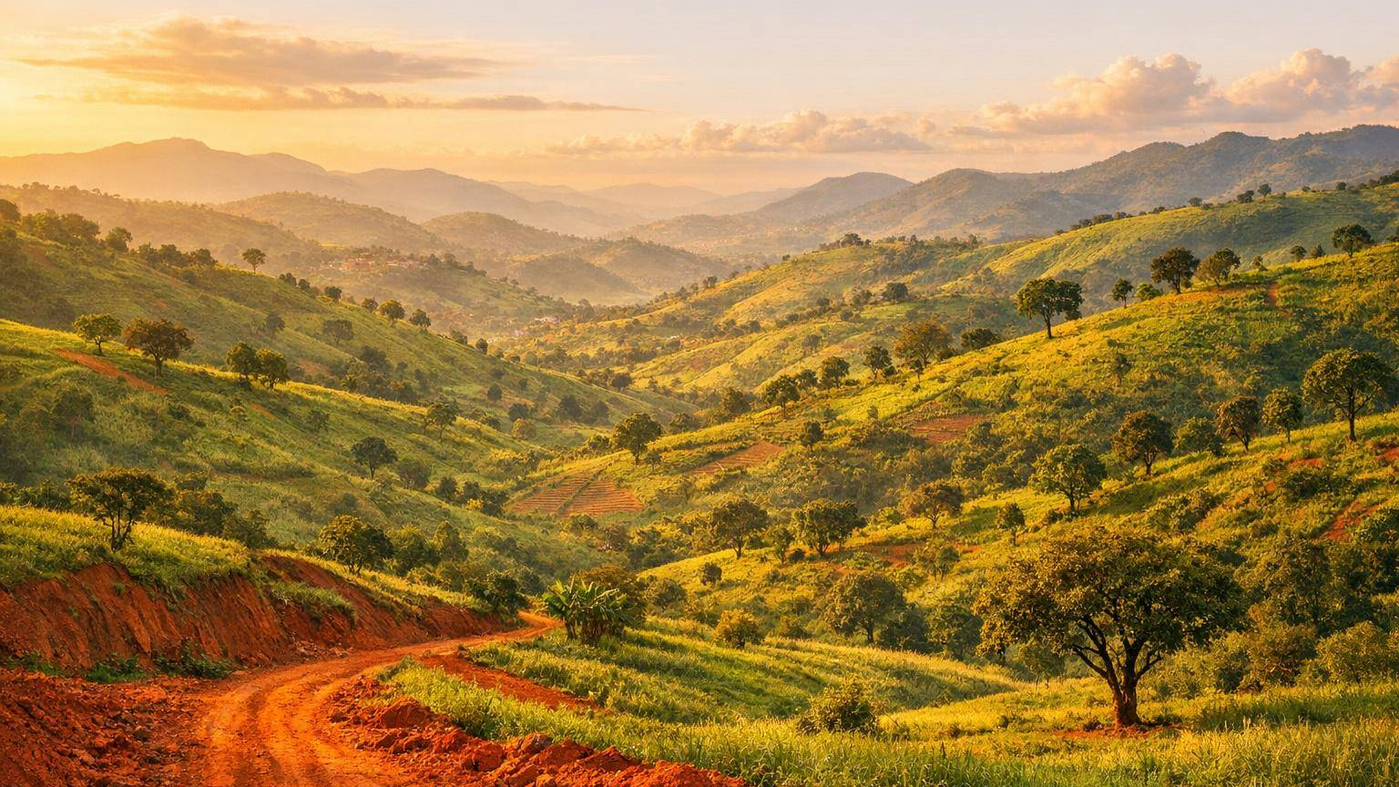
A JOURNEY OF PEACE
The Pope's Visit to Bamenda
Pope Leo XIV in Cameroon
Thursday 16 April 2026

Slide 2
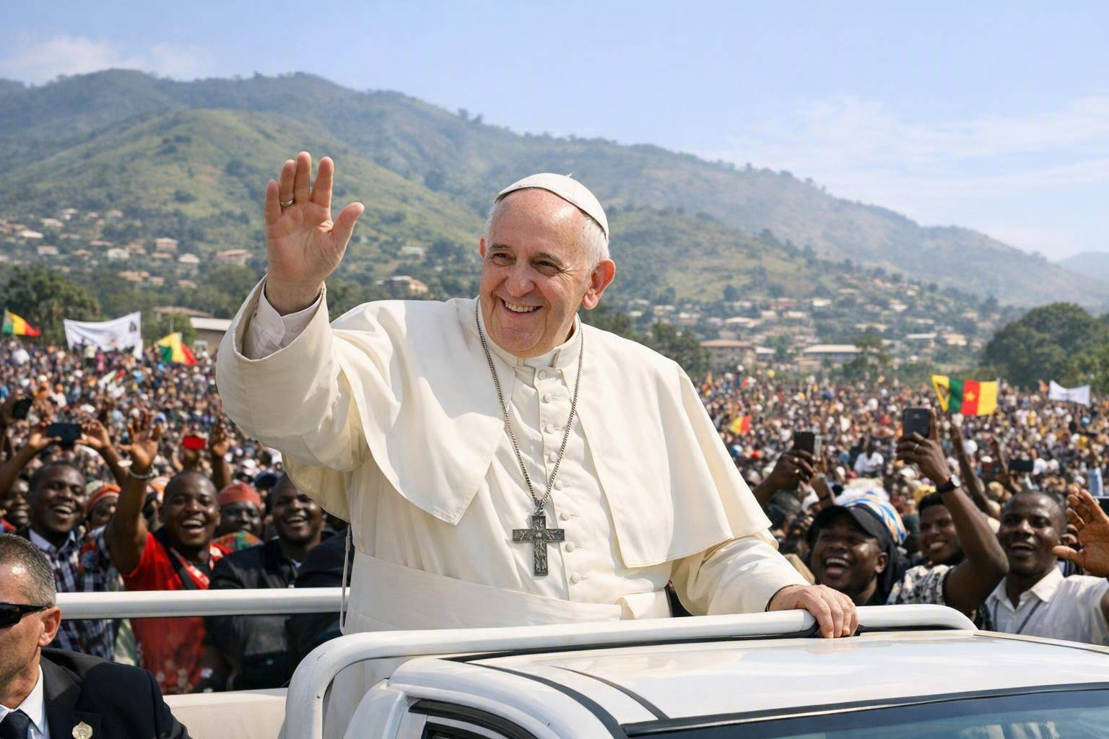
Who is the Pope?
The Pope leads the Catholic Church all around the world.
Today he is called Pope Leo XIV, a ‘pilgrim of peace’.
He travels to meet people and share God’s love.
“As a pilgrim of peace and unity, it is a joy for me to visit your region.”
— Pope Leo XIV
2

Slide 3
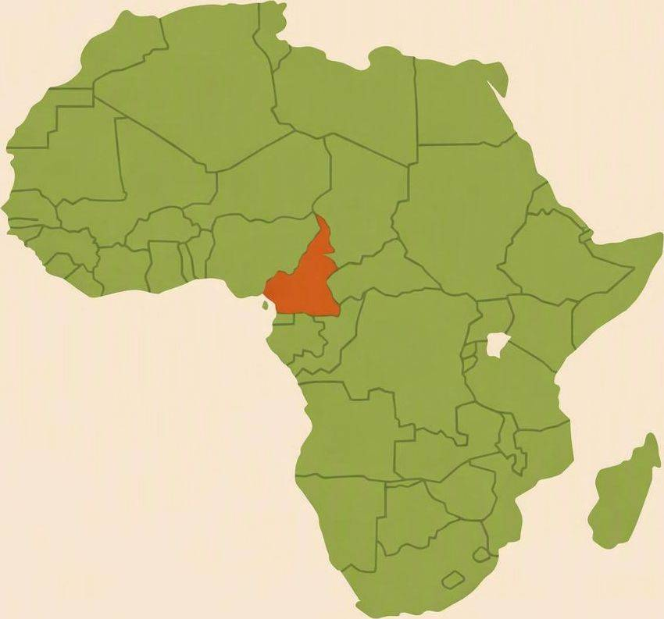
Where is Bamenda?
Bamenda is a city in Cameroon, in West Africa.
It sits high among beautiful green hills.
Many people there speak English, just like us.
The Pope visited on 16 April 2026 with a message of peace.
3

Slide 4
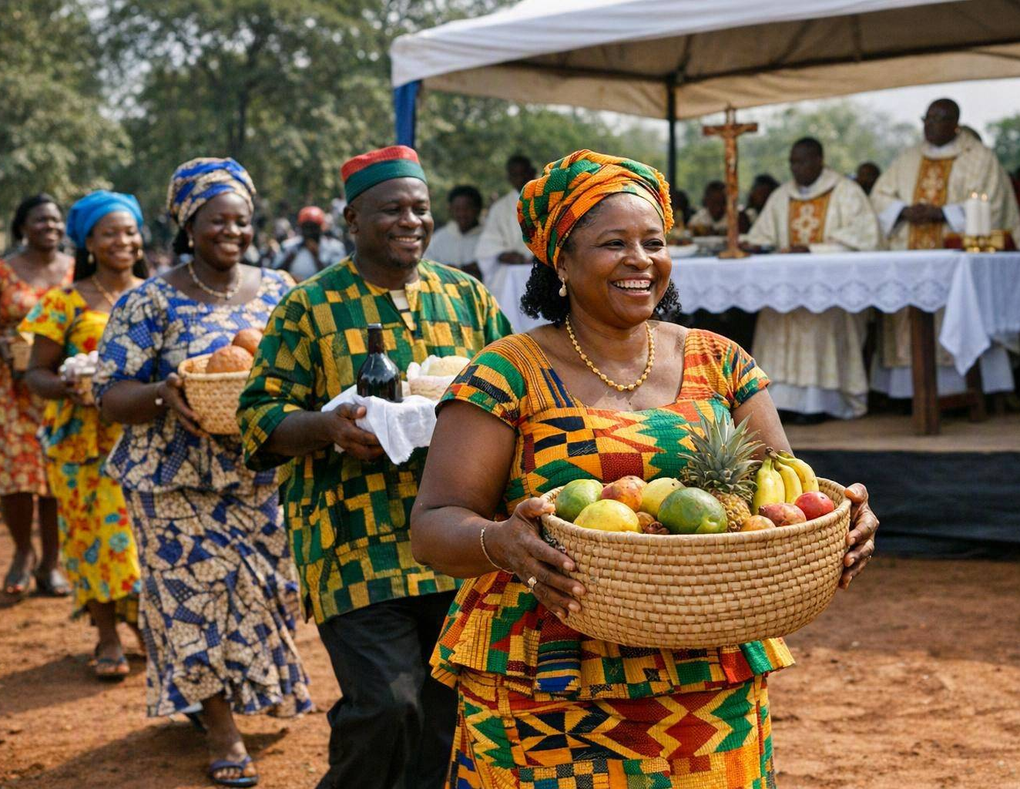
A Region Hoping for Peace
For years, this region has known fighting and hard times.
Many families left home, but kept their faith and hope.
Christians and Muslims now work together for peace.
“In God, in his peace, we can always begin anew!”
— Pope Leo XIV
4

Slide 5
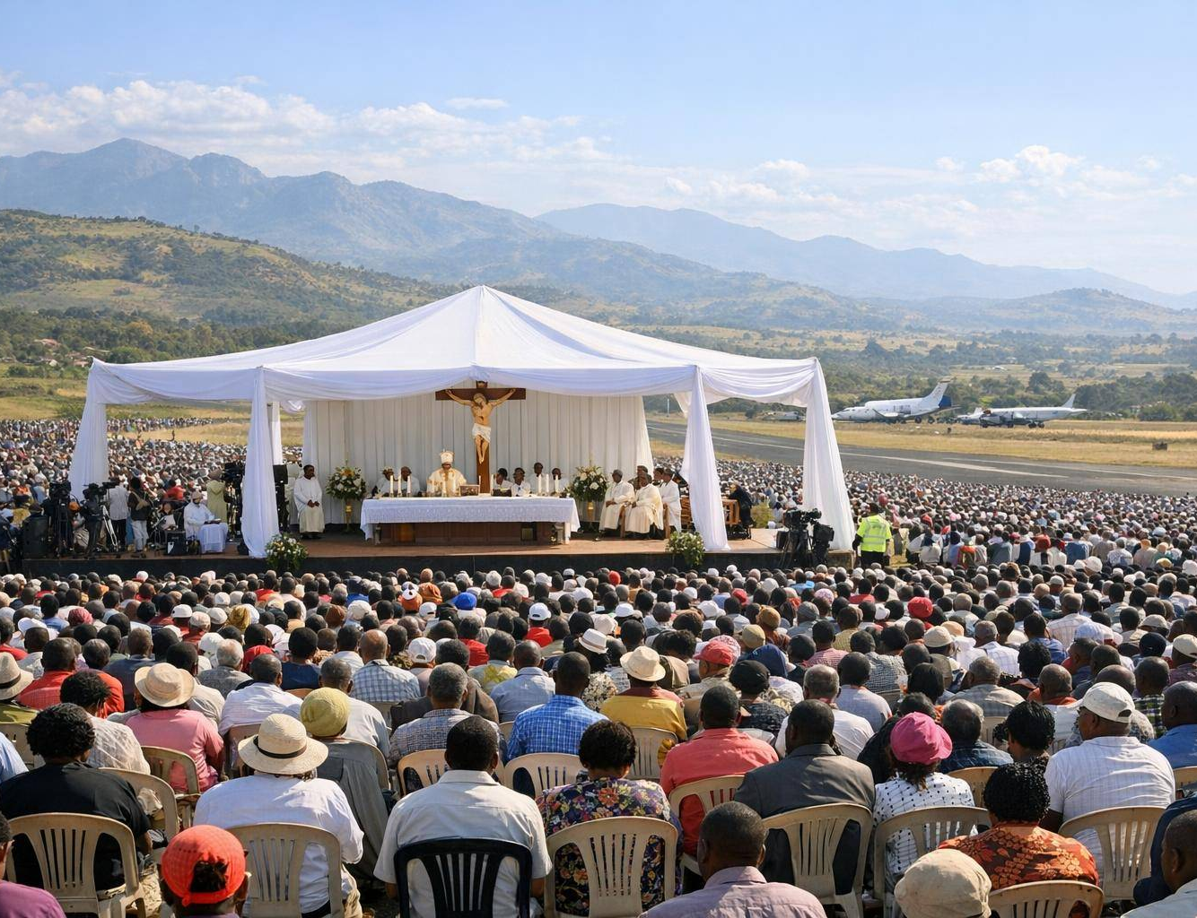
A Meeting for Peace
The Pope’s first stop was Saint Joseph’s Cathedral.
Leaders of different faiths met to talk about peace.
Crowds welcomed him, singing and dancing with joy.
He thanked all those working to heal and forgive.
5

Slide 6
“
I am here to proclaim peace.
Yet I find it is you who are proclaiming peace to me, and to the entire world.
— Pope Leo XIV, at the Meeting for Peace in Bamenda

Slide 7
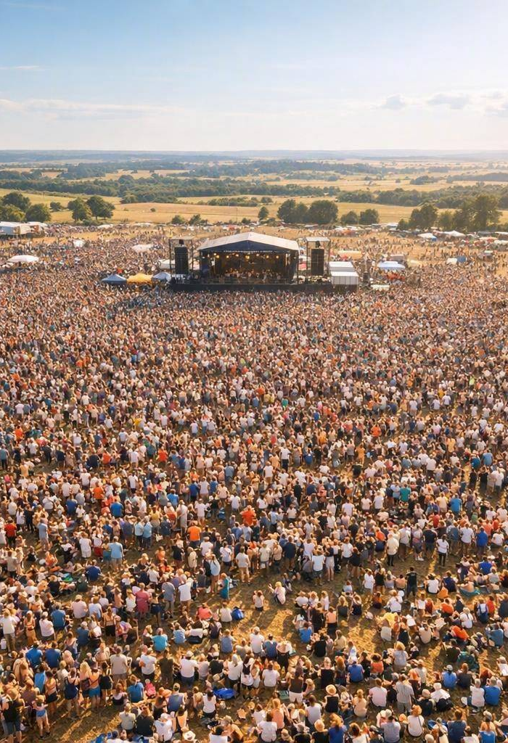
A Great Open-Air Mass
In the afternoon, the Pope led Mass at Bamenda airport.
About 20,000 people came together to pray.
He said the time for peace is now — ‘today, not tomorrow’.
It was a joyful day of hope for the region.
7

Slide 8
“
Blessed are the peacemakers!
Bamenda, today you are the city on the hill, resplendent in the eyes of all!
— Pope Leo XIV

Slide 9
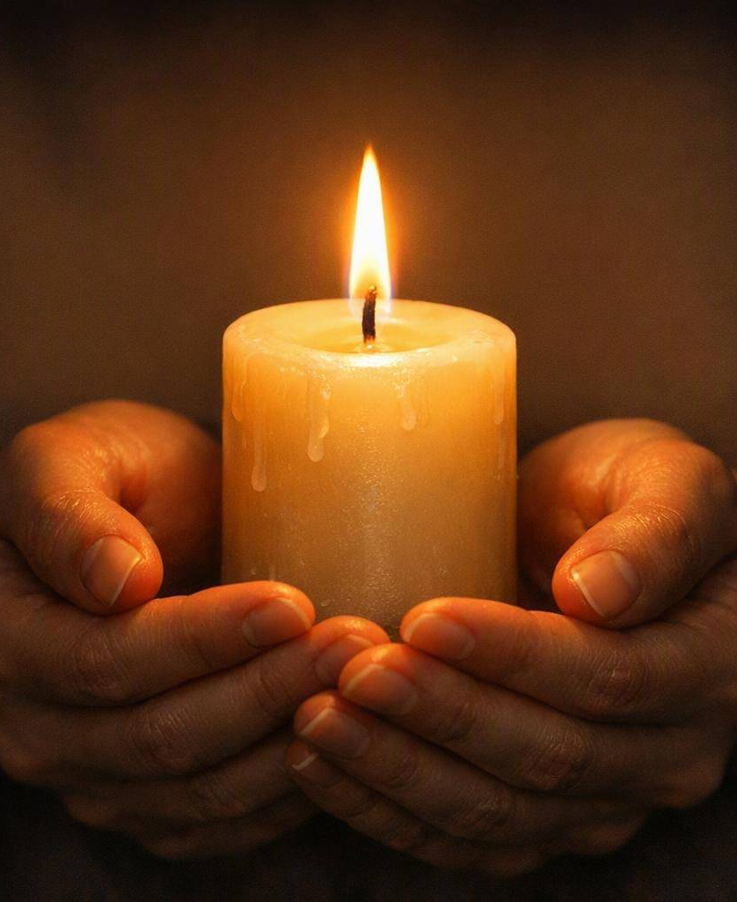
A Prayer for Peace
Loving God,
thank you for the gift of peace.
Help us to be kind with our words,
gentle with our hands,
and a friend to everyone we meet.
Bless the people of Bamenda,
and bring peace to our whole world.
Amen.

Slide 10
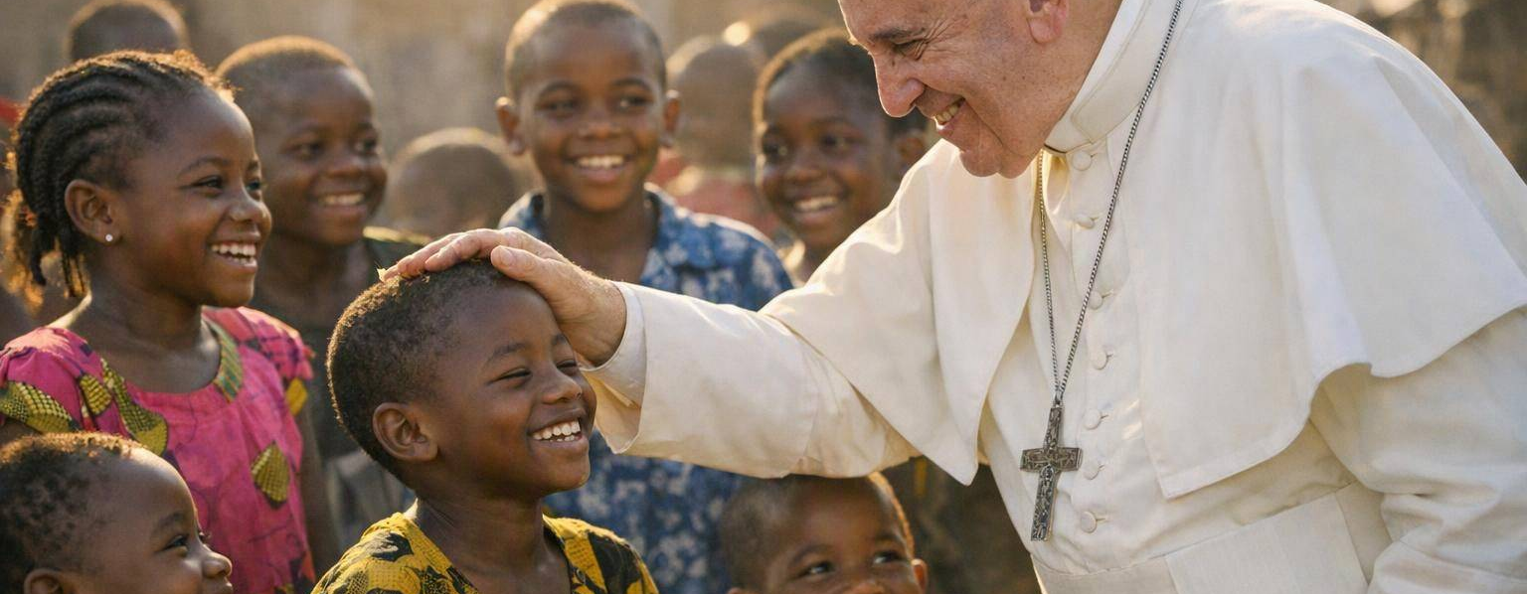
“Your work for peace can be a model for the whole world!”
— Pope Leo XIV
We Can Be Peacemakers
Be kind and welcoming, like the people of Bamenda.
Use gentle words and help anyone who is sad.
Pray for peace,and be a peacemaker every day.
10

