Slide 1
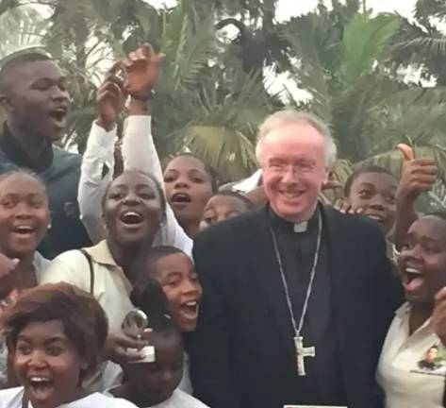
A LITURGY FOR KS3
Life to the Full
Hearing the call of John 10:10.
The Portsmouth – Bamenda Diocesan Link
“I came that they may have life,
and have it abundantly.”
John 10:10
Key Stage 3 Religious Education

Slide 2
I. WE GATHER
Coming Together in Prayer
Leader:
In the name of the Father, and of the Son, and of the Holy Spirit.
All:
Amen.
OPENING PRAYER
Loving God, you sent your Son so that we might know life in its fullness. Open our hearts today to hear his voice. Help us to see Christ in every person, especially our brothers and sisters in the diocease of Bamenda in Cameroon. Make us shepherds of compassion in our world. We ask this through Christ our Lord.
Amen.
Life to the Full · John 10:10
Slide 2 of 9

Slide 3
II. WE LISTEN
A Reading from the Gospel of John
John 10:7–11
“
So Jesus again said to them, ‘Truly, truly, I say to you, I am the gate for the sheep…
I came that they may have life, and have it abundantly.
I am the good shepherd. The good shepherd lays down his life for the sheep.’
The Gospel of the Lord.
Praise to you, Lord Jesus Christ.
Life to the Full · John 10:10
Slide 3 of 9

Slide 4
III. WE REFLECT
What does “life to the full” mean to our diocesan link with Bamenda?
Jesus is not promising a life of luxury or comfort. He is promising something deeper:
PAUSE & PONDER
If Jesus came so that everyone might have life to the full…
what does it say about us when our brothers and sisters do not have access to adequate schooling, medicine, or safety?
Dignity — every person made in God’s image.
Belonging — known, loved, never alone.
Hope — a future worth working for.
Justice — the basics every life needs: food, water, safety, learning, faith.
Life to the Full · John 10:10
Slide 4 of 9

Slide 5
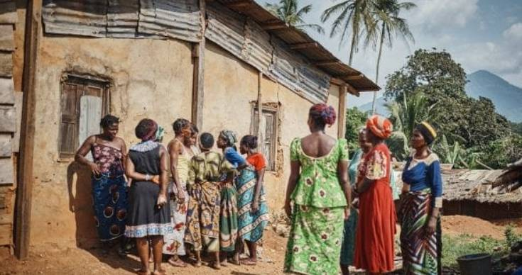
IV. WE LEARN
Catholic Social Teaching
Three principles that shape how we can respond to our link with Cameroon:
Human Dignity
Solidarity
Option for the Poor
Every person is made in the image of God. A child in Bamenda Cameroon and a child in England share the same worth.
We belong to one human family. Their hunger is our hunger. Their joy is our joy.
The Gospel asks us to put the poorest first — to hear their voice before our own.
Life to the Full · John 10:10
Slide 5 of 9

Slide 6
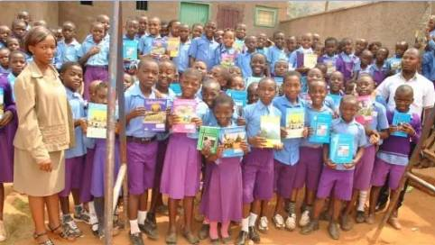
V. WE SEE
Life Cut Short: a World of Need
Where “life to the full” is hardest to reach:
Due to recent conflicts, many schools became unsafe and were damaged, forcing children to miss their education for about 6 years.
The Archbishop of Bamenda and donations from us, helped fund the education of 300 children last year.
.
In the region of Bamenda, children pay to attend school. Many families can not afford to send their children.
Donations to the Bamenda committee go directly to fund projects for schools, communities and health facilities in Bamenda.
.
Life to the Full · John 10:10
Slide 6 of 9

Slide 7
VI. WE RESPOND
Shepherds for Our Brothers and Sisters
WAYS WE CAN ACT
“The good shepherd lays down his life for the sheep.”
Pray daily for the people of Bamenda, especially the staff and students in Bamendan Schools.
Learn about the Bamenda – Portsmouth link.
Give support the Bamenda Sunday appeal, or through your school’s twinned school in Bamenda.
Live simply so others may simply live.
Speak up tell others about our link with the diocese of Bamenda in Cameroon.
John 10:11
Christ lays down his life. We are asked to lay down our comfort, our time, our voice — so others may live more fully.
Life to the Full · John 10:10
Slide 7 of 9

Slide 8
VII. WE PRAY
Prayers of Intercession
Response:
“Lord, give them life to the full.”
For our brothers and sisters in Bamenda: that they may have safe homes and schools and inspiring places to learn…
For children, in Bamenda, whose schooling has been interrupted by poverty, conflict, or hunger: that they may know learning, dignity, and the joy of childhood…
For mothers, fathers, and carers who do all they can with little: that the world may meet them with justice, not pity…
For leaders of nations and of the Church: that they may serve the poorest first, as Christ the Good Shepherd does…
For ourselves, here in this classroom: that we may turn faith into action, and not look away…
Leader:
We ask all this through Christ our Lord. All: Amen.
Life to the Full · John 10:10
Slide 8 of 9

Slide 9
VIII. GOING FORTH
Go and Give Life
CLOSING PRAYER
Good Shepherd, you came so that all might have life, and have it abundantly.
Send us out from this place not as we came in.
Make our hands generous, our words gentle, our hearts brave —
so that our brothers and sisters in Bamenda may know your fullness of life.
Amen.
Leader:
Go in peace to love and serve the Lord.
All:
Thanks be to God.

