Slide 1
DISCUSSION QUESTIONS
KS3 • RELIGIOUS EDUCATION
Talk it through with the person next to you.
Starter:
Why does
overseas
development
matter?
1
Why help?
Why might people who have plenty want to help people in another country they have never met?
2
What counts as 'development'?
What sort of things do communities need to thrive — and who decides what "help" should look like?
3
A duty or a choice?
Catholic Diocese of Portsmouth ✦ Archdiocese of Bamenda, Cameroon
As Catholics, do we have a duty to support people far away? What might Jesus say about it?
Year 8 RE • Portsmouth & Bamenda • Slide 1 of 8

Slide 2
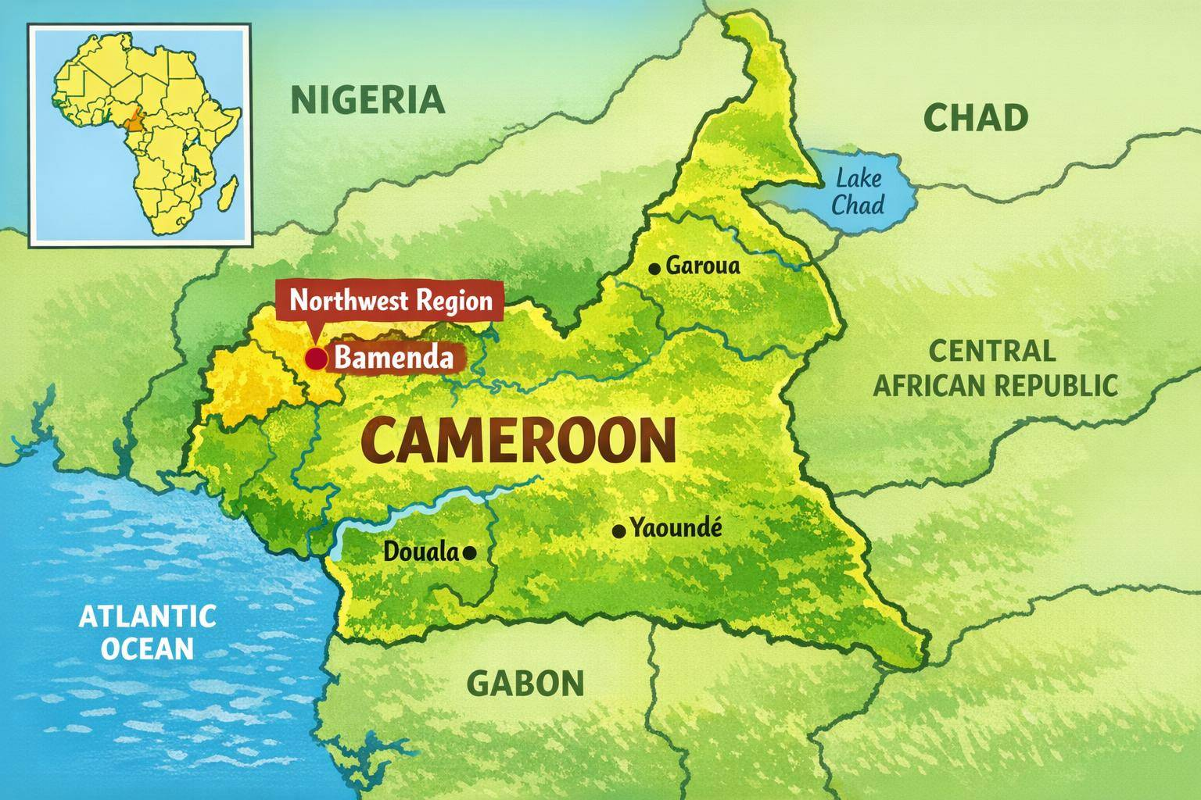
GETTING OUR BEARINGS
Where in the world is Bamenda?
Quick facts
Country
Cameroon, West Africa
Region
Northwest Region (Anglophone)
City elevation
1,614 m above sea level
Population
around 600,000 people
Language
English & Cameroonian Pidgin
Distance from UK
approximately 5,000 km
Year 8 RE • Portsmouth & Bamenda • Slide 2 of 8

Slide 3
OUR STORY
A golden partnership: 50+ years of friendship
In 1974, Bishop Derek Worlock of Portsmouth and Bishop Paul Verdzekov of Bamenda twinned our two dioceses — a living response to the Vatican II document Gaudium et Spes ("Joy and Hope").
1970
1982
Diocese of Bamenda founded by Pope Paul VI
Bamenda elevated to Archdiocese
2024
1974
2014
Golden Jubilee — 50 years of friendship
Portsmouth & Bamenda twinned; first priests sent out
40th anniversary celebrated by both dioceses
Priests sent
£1 million+ raised
Two-way friendship
Portsmouth → Bamenda in the 1970s; today five Bamendan priests serve in Portsmouth parishes.
Portsmouth parishioners have given over £1m for projects in Bamenda.
Bishops, priests and lay people regularly visit each other.
Year 8 RE • Portsmouth & Bamenda • Slide 3 of 8

Slide 4
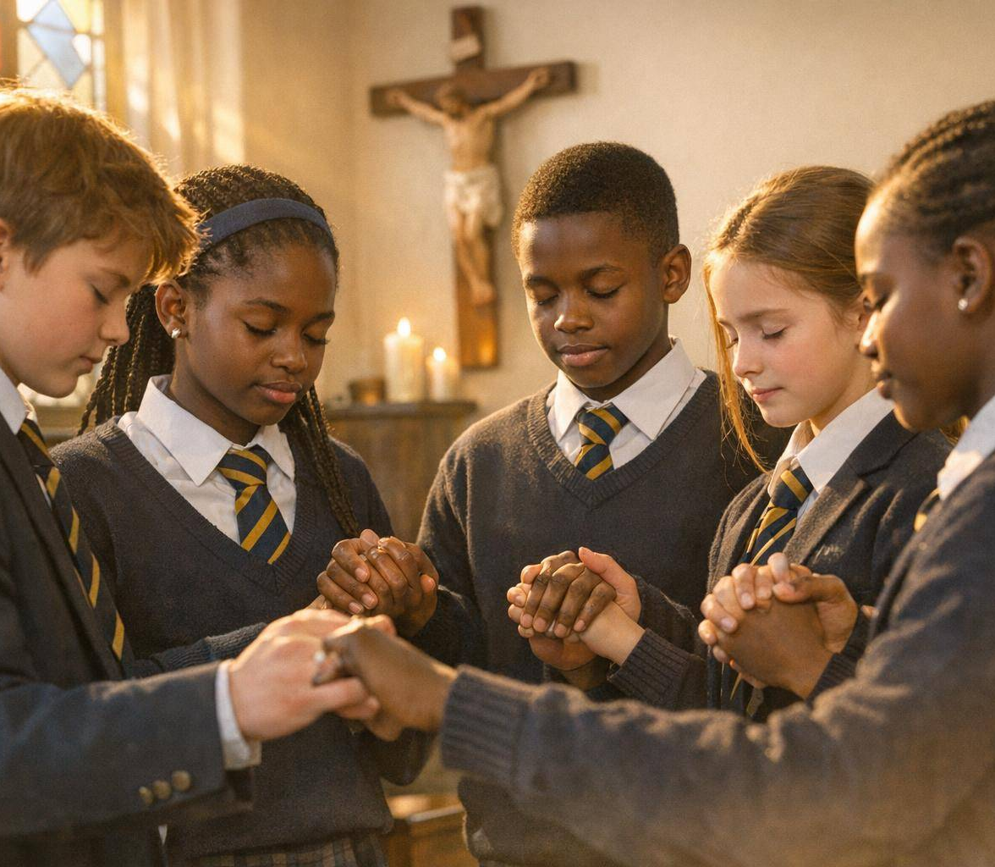
FAITH IN BAMENDA
A flourishing Catholic community
42%
615,000+
of the population is Catholic
Catholics in the Archdiocese
57
168
parishes across the region
priests serving the community
The Church is growing fast — most masses last more than two hours, and many churches are bursting at the seams with young people.
Year 8 RE • Portsmouth & Bamenda • Slide 4 of 8

Slide 5
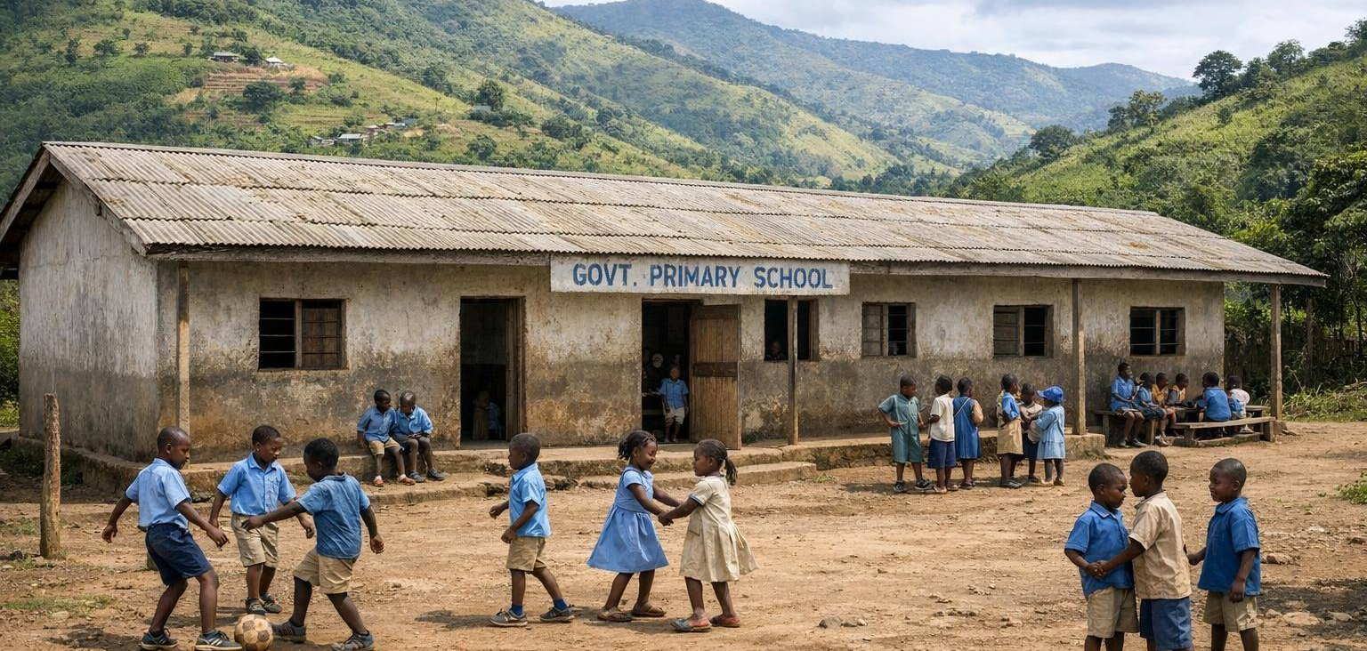
EDUCATION
Catholic schools in Bamenda
123
38,000
30
11,000
Catholic nursery & primary schools
primary pupils
secondary schools
secondary students
How is school different from yours?
One school built for 300 pupils may host over 650.
Classrooms often have bare concrete or mud floors.
Children share textbooks; there are no tablets or laptops.
Most teaching is done with a single blackboard.
More than half of pupils live in rural parishes hit by conflict and poverty.
A typical Catholic primary school in the hills around Bamenda.
Year 8 RE • Portsmouth & Bamenda • Slide 5 of 8

Slide 6
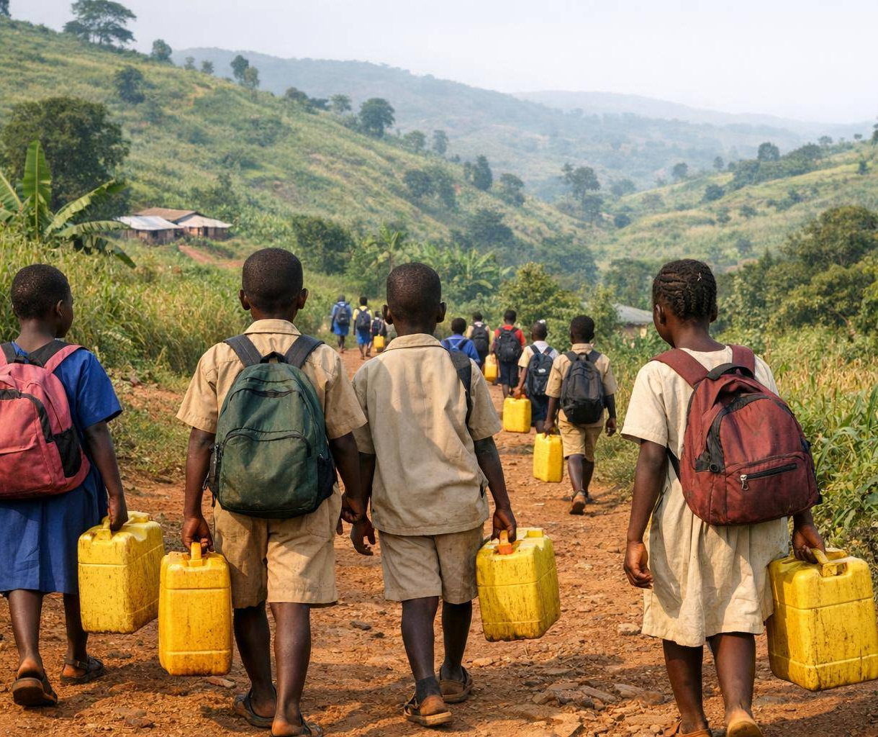
DAILY LIFE
A day in the life of a Bamenda pupil
A typical school day
5:30
Wake early; help with chores and collect water for the family.
7:00
Walk to school — often several miles, sometimes barefoot.
8:00
Morning prayer and assembly; lessons begin.
12:30
Lunch — for some, the one warm meal of the day, thanks to school feeding programmes.
13:30
Afternoon lessons; older pupils help younger ones.
16:00
Walk home, fetch more water, help on the family farm, then homework.
Many pupils fetch water from streams before walking to school.
Year 8 RE • Portsmouth & Bamenda • Slide 6 of 8

Slide 7
WALKING TOGETHER
How Portsmouth supports Bamenda
Each year on Bamenda Sunday — the first Sunday of November — parishes across Portsmouth Diocese collect to support our sister Archdiocese. Over the last 50 years, more than £1 million has been given.
01
Education Fund
02
Refurbishing Schools
Helped 276 students with scholarships and 500 pupils with daily meals in 2024.
Solar panels at St Bede's College, Ashing-Kom and a new nursery in Ntenefor.
03
Building Faith
04
Health & Welfare
New church buildings, training of priests and pastoral resources.
Equipping St Blaise Hospital theatre and supporting community health workers.
School twinning: 10+ Portsmouth schools are linked with schools in Bamenda — sharing prayer, letters, projects and fundraising.
Year 8 RE • Portsmouth & Bamenda • Slide 7 of 8

Slide 8
CATHOLIC SOCIAL TEACHING
Solidarity: one human family
“
What can we do?
PRAY
Remember our sisters and brothers in Bamenda in our prayers, especially those affected by conflict.
Solidarity is not a feeling of vague compassion… it is a firm and persevering determination to commit oneself to the common good.
LEARN
Find out about life in Cameroon and share what we discover with families and friends.
ACT
Take part in Bamenda Sunday, fundraise as a school, or write to a twinned class in Bamenda.
— Pope St John Paul II
REFLECT
"Whatever you did for one of the least of these brothers and sisters of mine, you did for me." — Matthew 25:40
Year 8 RE • Portsmouth & Bamenda • Slide 8 of 8

