Slide 1
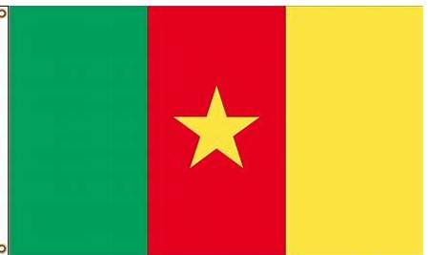
Bamenda Diocese
Cameroon and
Portsmouth Diocese
Since 1974

Slide 2
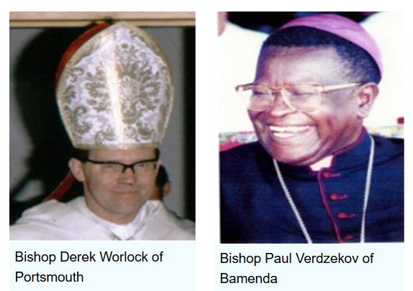
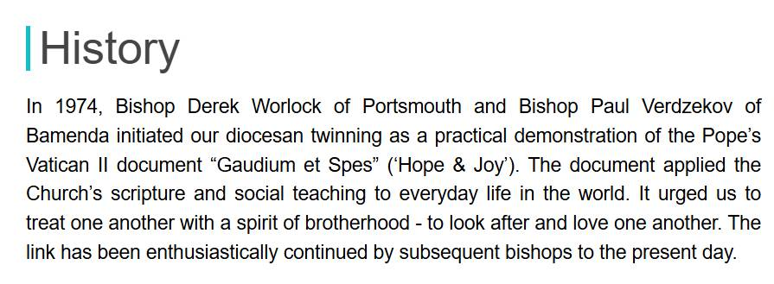
The beginning
1974

Slide 3
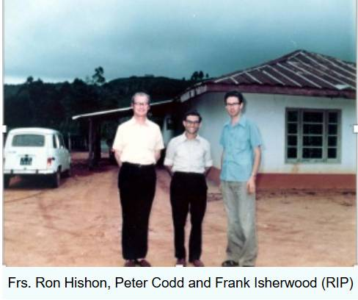
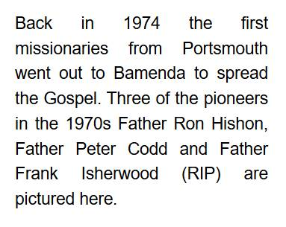
Early Years

Slide 4
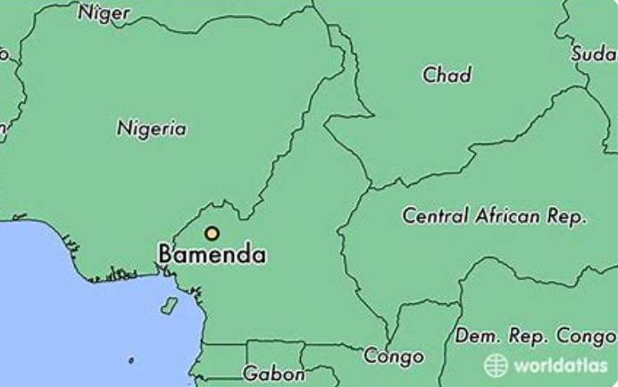
Where is Bamenda, Cameroon?
Bamenda is the capital city of the Northwest Province of the country Cameroon.
This province is mostly English speaking; whereas, most of the rest of the country speaks French.
Cameroon is in Western Africa,
On the equator
Just South of Nigeria.

Slide 5
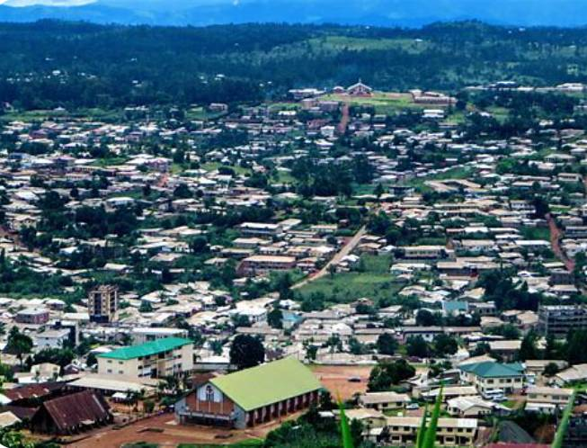
The city of Bamenda has a population of about
350,000.

Slide 6
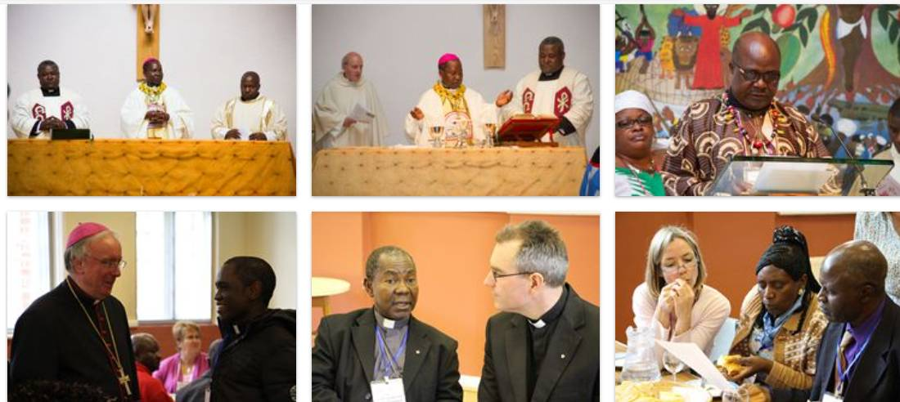
Working together over the years

Slide 7
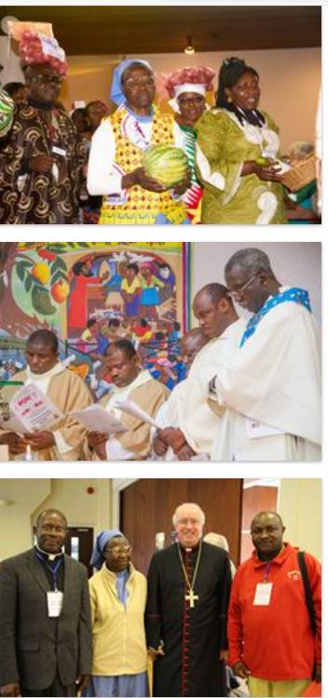
Health and Welfare
Education and Schools
Peace and Justice
Faith and Evangelisation
John 10:10
I have come that they may have life, and have it in all its fullness

Slide 8
How it works:
In Bamenda there are many priests, religious and laity who work to improve the lives of the people of the Bamenda Diocese.
These people put forward ideas and projects that will benefit the local people.
In the UK, the Bamenda Committee works to raise awareness of our link especially on
Bamenda Sunday (the first Sunday of November)
The committee works to raise money to fund projects
The UK committee then reviews the projects sent by the people of Bamenda and tries to support as many as possible using the funds they have raised across the Portsmouth diocese.

Slide 9
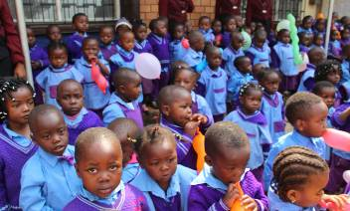
Currently
Not only are we able to fund several projects related to:
Health and Welfare
Education and Schools
Peace and Justice
Faith and Evangelisation
But also…
There are several priests from the Bamenda Diocese who come to Portsmouth Diocese to work and support our churches and diocese for several years at a time.

Slide 10
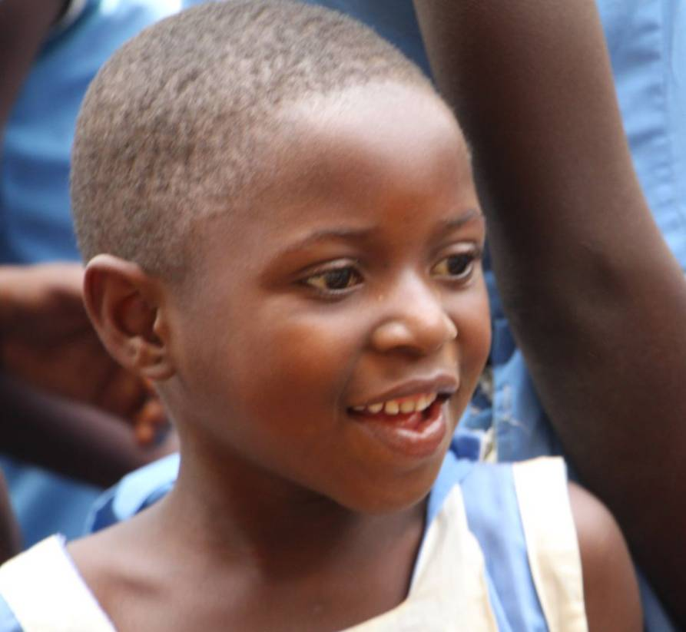
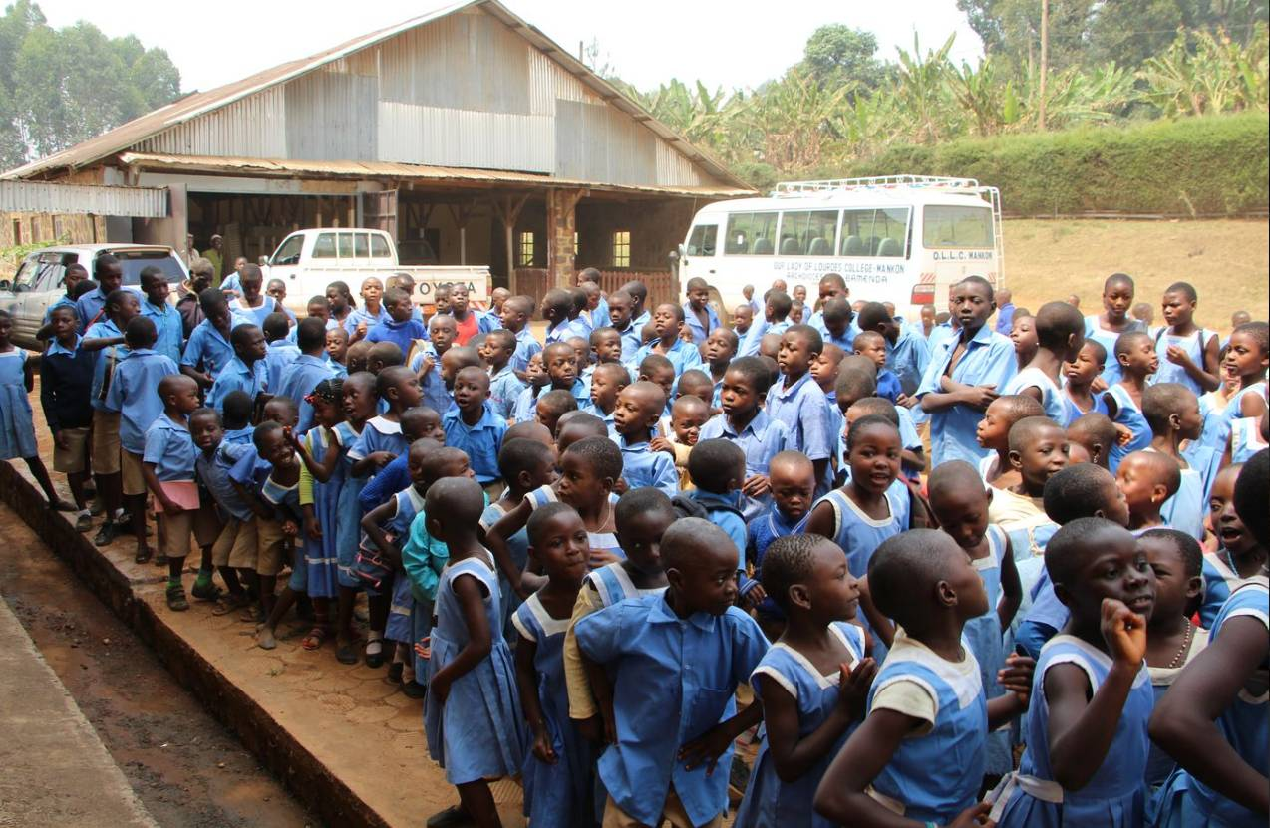
Bamenda Diocese is a place of inspirational faith!

Slide 11
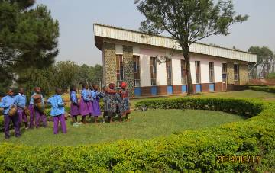
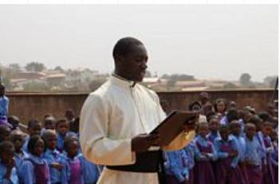
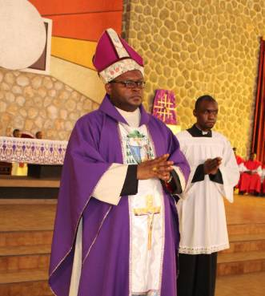
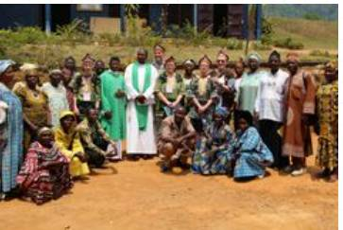
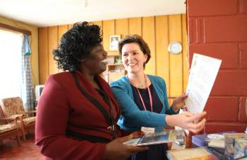

Slide 12
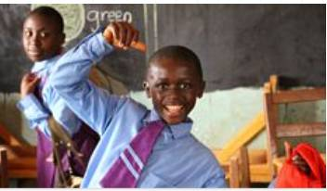
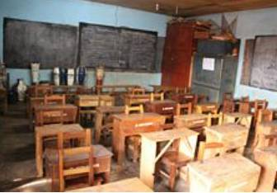

Slide 13
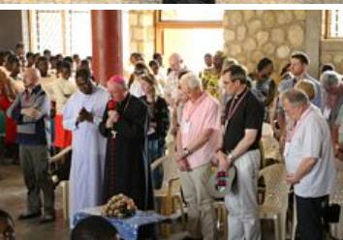
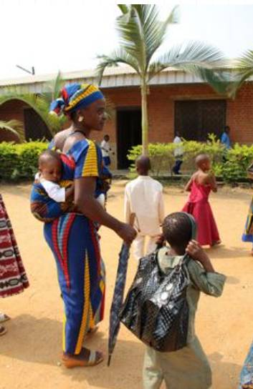
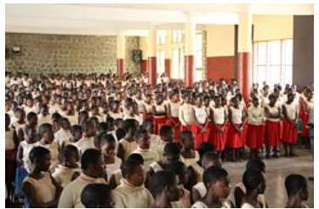
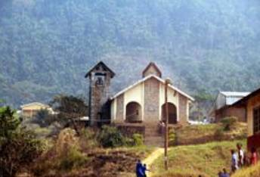
How can we get involved?
1. Learn more at www.bamendaandportsmouth.com
Bamenda and Portsmouth (link)
2. Pray for the people of Bamenda, Portsmouth and our link
Raise money for a project
School twinning

