Slide 1
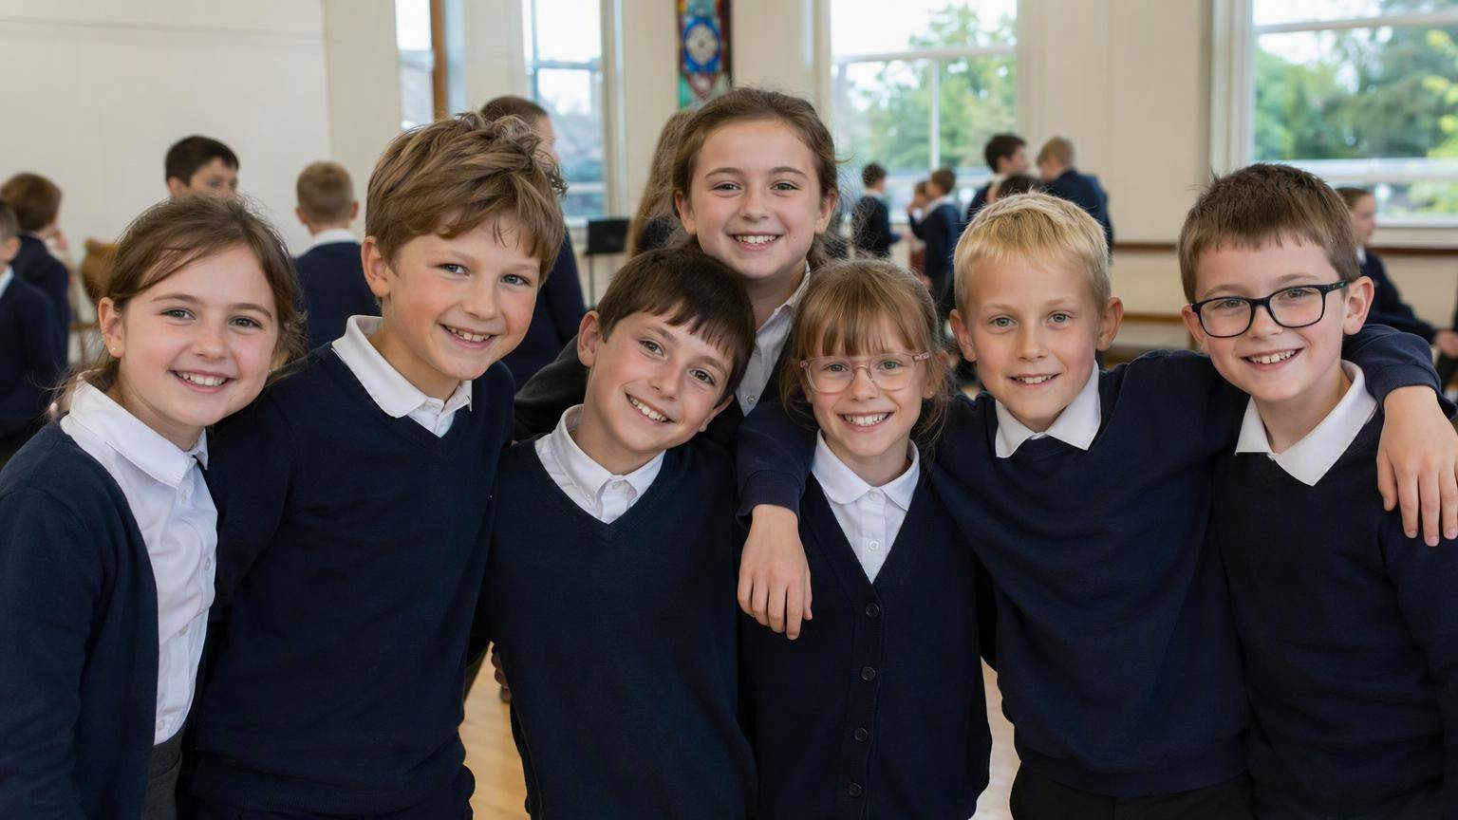
Life to the Full
KEY STAGE 2 COLLECTIVE WORSHIP
“I have come that they may have life, and have it to the full.” John 10:10
Diocese of Portsmouth ✝ Archdiocese of Bamenda

Slide 2
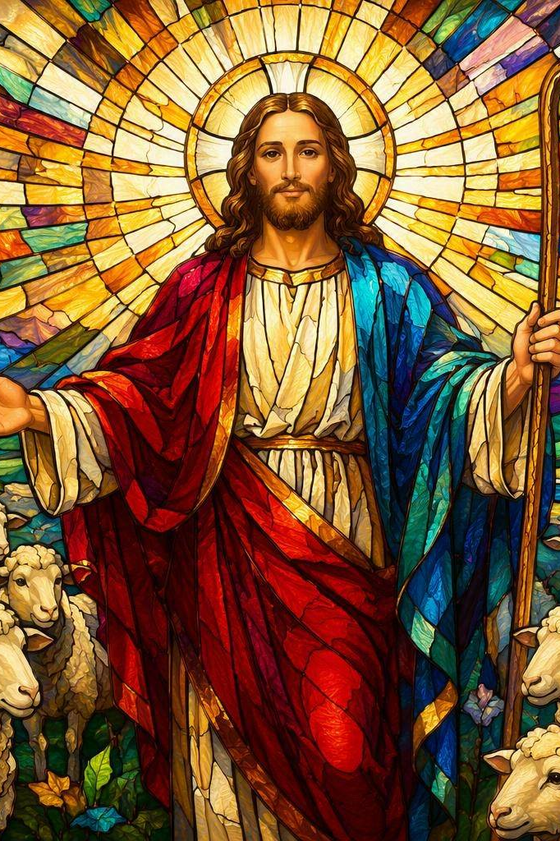
We Come Together
PART ONE · WE GATHER
Leader: In the name of the Father, and of the Son, and of the Holy Spirit.
All: Amen.
Leader: Jesus said, ‘I have come to bring life to the full.’ Today we thank God for our friends in Bamenda.
All: Loving God, bring us together as one family. Amen.

Slide 3
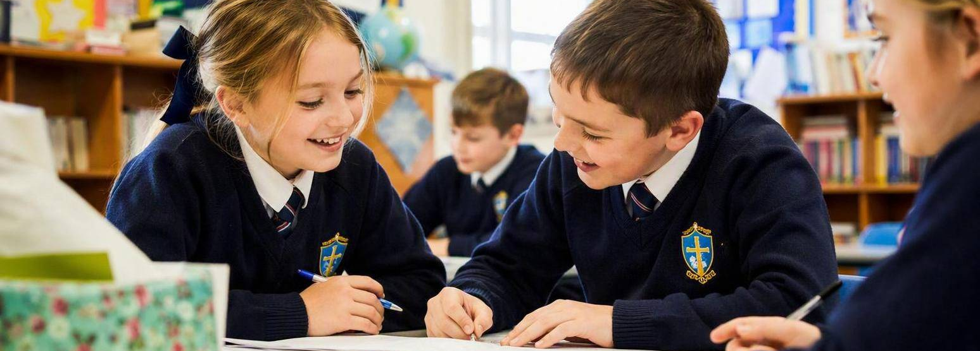
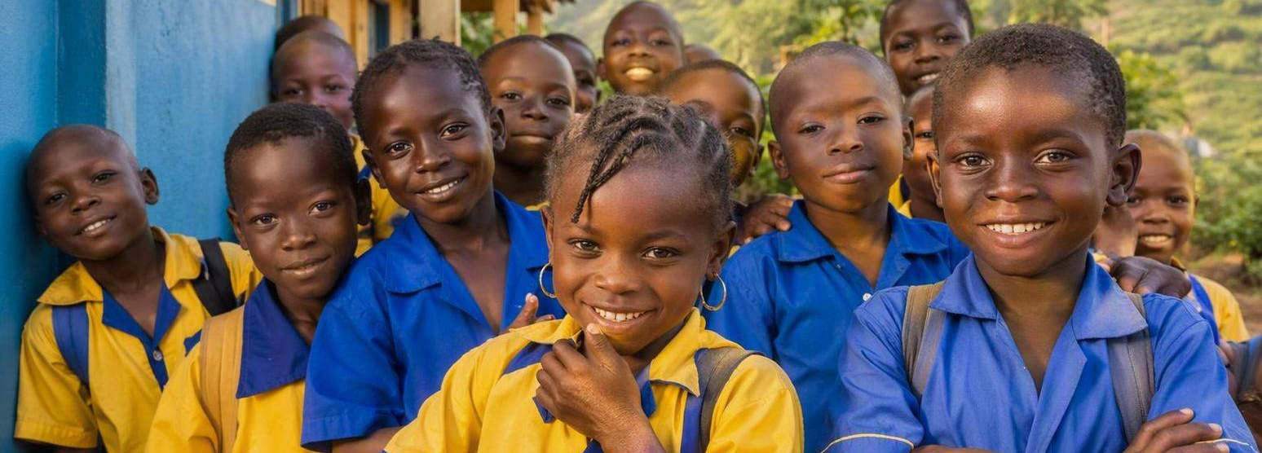
Two Schools, One Family
PART ONE · WE GATHER
Diocese of Portsmouth
Archdiocese of Bamenda
We pray for our Bamenda friends especially on Bamenda Sunday.
The first Sunday in November.
The people of Bamenda pray for all of us, here in Portsmouth Dioseae on Portsmouth Sunday.
Friends since 1974 — in 2024 we celebrated 50 golden years!
Five priests from Bamenda now help in Portsmouth.

Slide 4
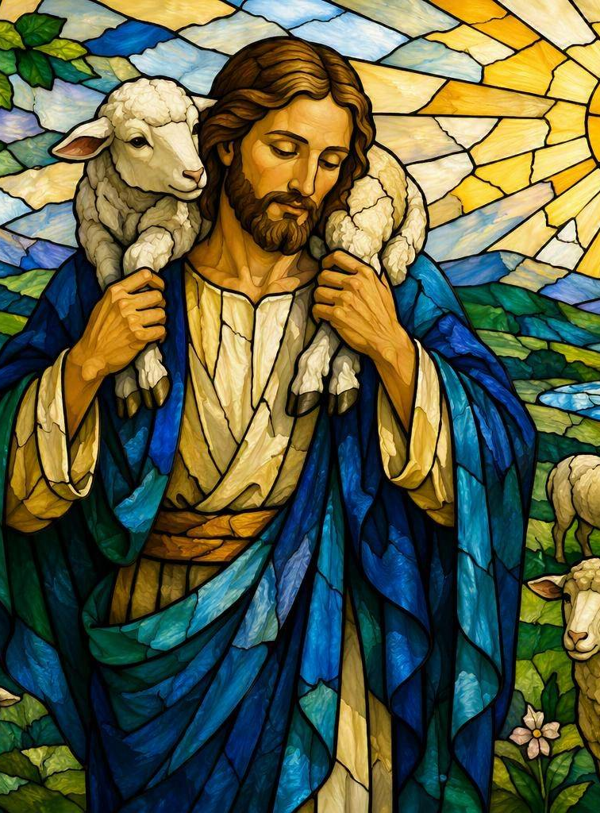
A Reading from the Gospel of John
PART TWO · WE LISTEN TO GOD’S WORD
Please stand. Gospel Acclamation: Alleluia!
“Jesus said: I am the good shepherd. I have come that they may have life, and have it to the full.”
John 10:10–11
Leader: The Gospel of the Lord.
All: Praise to you, Lord Jesus Christ.

Slide 5
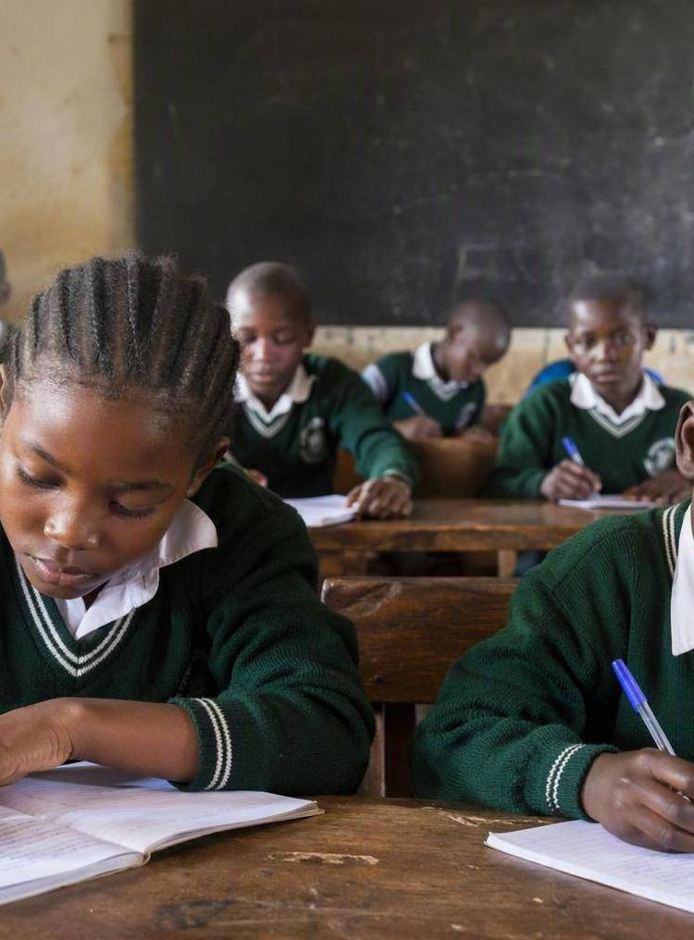
What is ‘Life to the Full’?
PART TWO · WE LISTEN TO GOD’S WORD
Jesus wants everyone, everywhere, to have a good and happy life:
Love, friendship and a happy family
Learning, playing and going to school
Faith, food, health and a safe home
When we help our friends in Bamenda go to school and stay well, we help them live life to the full — just as Jesus wants.

Slide 6
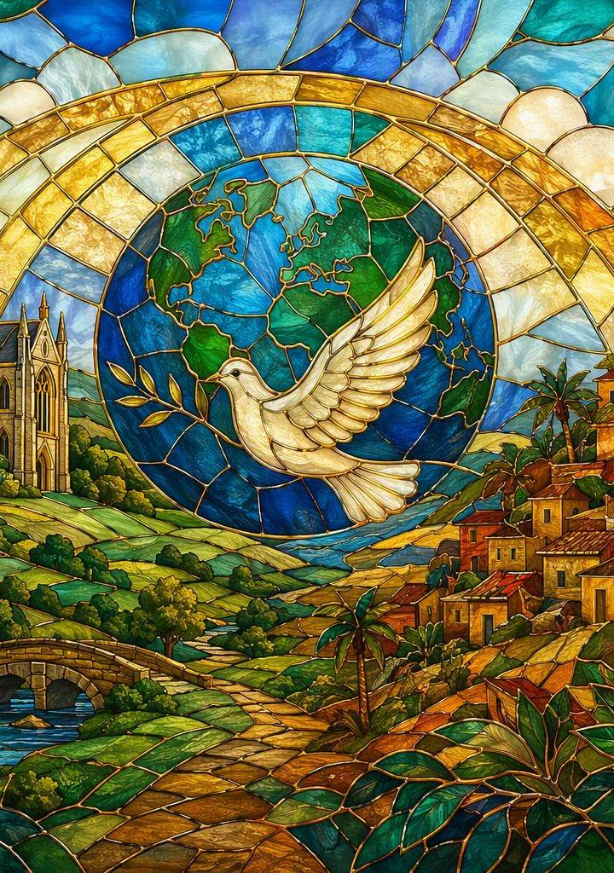
Prayers of Friendship
PART THREE · WE RESPOND
Our response is: ‘Lord, hear our prayer.’
For the Church, and our friends in both dioceses…
For children who need a school, food and health…
For peace in Cameroon and kindness at school…
For our friendship, that it keeps growing…
All: Lord, hear our prayer.

Slide 7
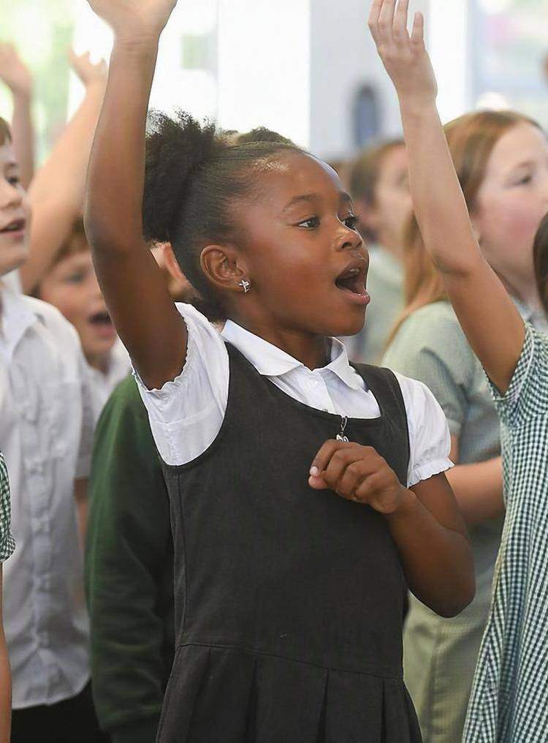
We Sing and We Promise
PART THREE · WE RESPOND
Our Song
Let us sing ‘Christ Be Our Light’
(or a hymn we know.)
Our Promise
All: This week I will be a good friend — I will pray for Bamenda and share what I can.
✚ Sign of peace: turn to a friend and say, ‘Peace be with you.’
Bing Videos (music & lyrics link Christ Be Our Light)

Slide 8
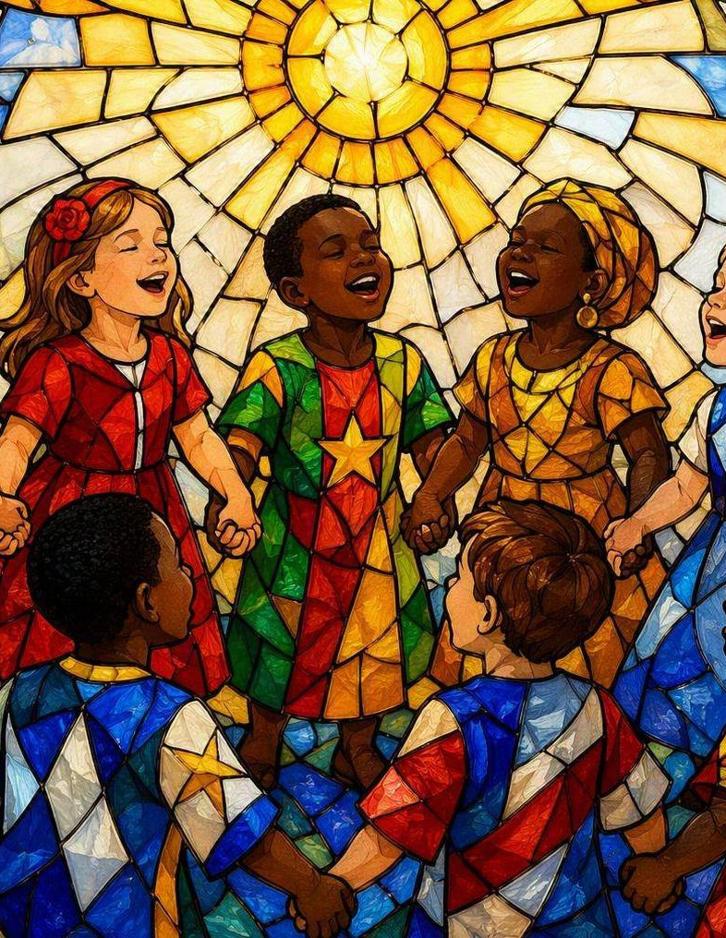
Go in Peace
PART FOUR · WE GO OUT
Leader: May God bless us, and our friends in Bamenda, and keep us one family in his love.
All: Amen.
Leader: Go in peace to love and serve the Lord, and to bring life to the full to others.
All: Thanks be to God.
Portsmouth & Bamenda — friends in Christ.

